Slide 1

의료정보학시스템
Device on FHIR 4
Dept. of Computer Science & Engineering
College of IT
Kyungpook National University
2017.11.27.
fjrzlgnlwns@naver.com 권휘준 TA

Slide 2
Oxygen Saturation
<Observation xmlns="http://hl7.org/fhir">
<id value="satO2"/>
<meta>
<profile value="http://hl7.org/fhir/StructureDefinition/vitalsigns"/>
</meta>
<identifier>
<system value="http://goodcare.org/observation/id"/>
<value value="o1223435-10"/>
</identifier>
<status value="final"/>
<category>
<coding>
<system value="http://hl7.org/fhir/observation-category"/>
<code value="vital-signs"/>
<display value="Vital Signs"/>
</coding>
<text value="Vital Signs"/>
</category>
<code>
<coding>
<system value="http://loinc.org"/>
<code value="59408-5"/>
<display value="Oxygen saturation in Arterial blood by Pulse oximetry"/>
</coding>
<coding>
<system value="urn:iso:std:iso:11073:10101"/>
<!-- mdc -->
<code value="150456"/>
<display value="MDC_PULS_OXIM_SAT_O2"/>
</coding>
</code>
<subject>
<reference value="Patient/example"/>
</subject>
<effectiveDateTime value="2014-12-05T09:30:10+01:00"/>
<valueQuantity>
<value value="95"/>
<unit value="%"/>
<system value="http://unitsofmeasure.org"/>
<code value="%"/>
</valueQuantity>
<interpretation>
<coding>
<system value="http://hl7.org/fhir/v2/0078"/>
<code value="N"/>
<display value="Normal"/>
</coding>
<text value="Normal (applies to non-numeric results)"/>
</interpretation>
<device>
<reference value="DeviceMetric/example"/>
</device>
<referenceRange>
<low>
<value value="90"/>
<unit value="%"/>
<system value="http://unitsofmeasure.org"/>
<code value="%"/>
</low>
<high>
<value value="99"/>
<unit value="%"/>
<system value="http://unitsofmeasure.org"/>
<code value="%"/>
</high>
</referenceRange>
</Observation>

Slide 3
FHIR Validation
Validating a resource means, checking that the following aspects of the resource are valid:
Structure: Check that all the content in the resource is described by the specification, and nothing extra is present
Cardinality: Check that the cardinality of all properties is correct (min & max)
Value Domains: Check that the values of all properties conform to the rules for the specified types (including checking that enumerated codes are valid)
Coding/CodeableConcept bindings: Check that codes/displays provided in the Coding/CodeableConcept types are valid
Invariants: Check that the invariants (co-occurrence rules, etc.) have been followed correctly
Profiles: Check that any rules in profiles have been followed (including those listed in the Resource.meta.profile, or in CapabilityStatement, or in an ImplementationGuide, or otherwise required by context)
Questionnaires: Check that a QuestionnaireResponse is valid against its matching Questionnaire
Business Rules: Business rules are made outside the specification, such as checking for duplicates, checking that references resolve, checking that a user is authorized to do what they want to do, etc.

Slide 4
FHIR Validation
Hapi support FHIR validation Library.
You should implement Hapi validation code in java and define StructureDefinition code.

Slide 5
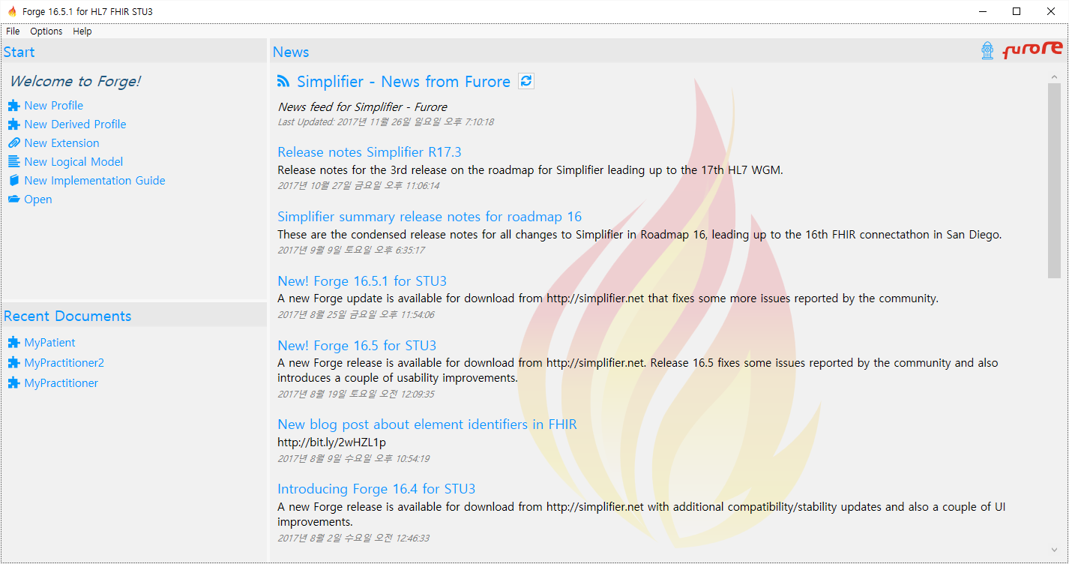
FHIR Validation
Define StructureDefinition in Forge

Slide 6
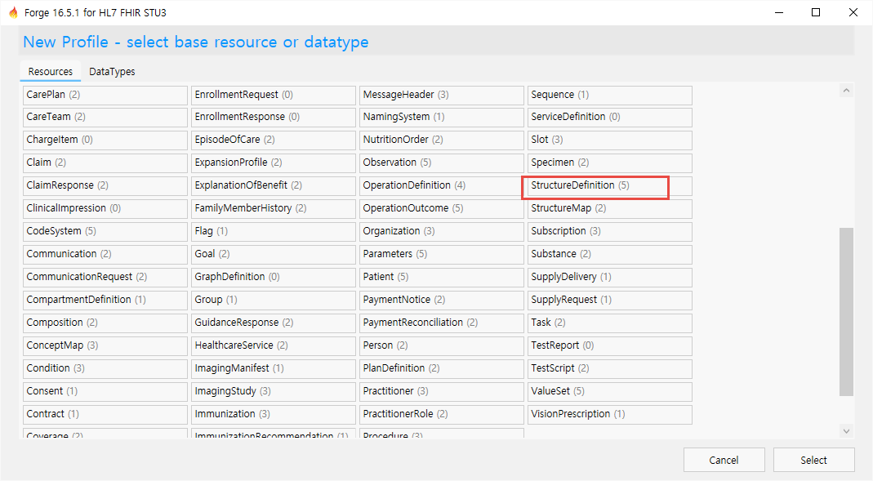
FHIR Validation
Define StructureDefinition in Forge

Slide 7
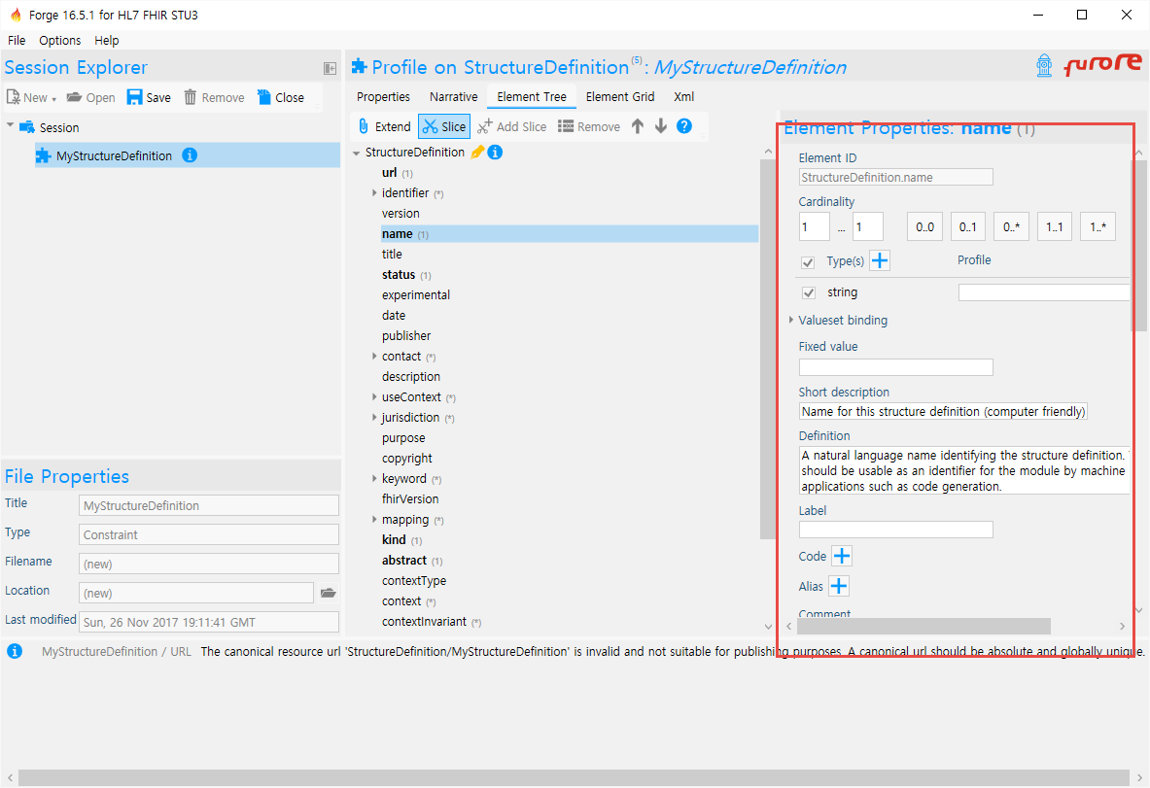
FHIR Validation
Define type, cardinality, code, value…

Slide 8
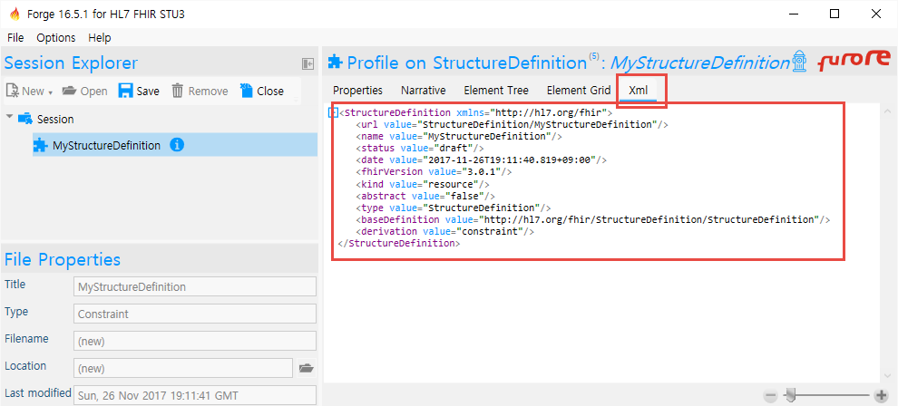
FHIR Validation
StructureDefinition is made.

Slide 9
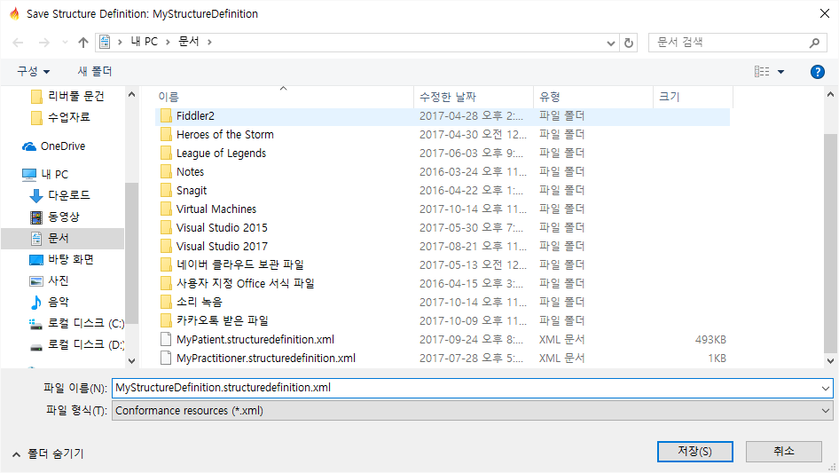
FHIR Validation
StructureDefinition is made.

Slide 10
FHIR Validation
Save

Slide 11
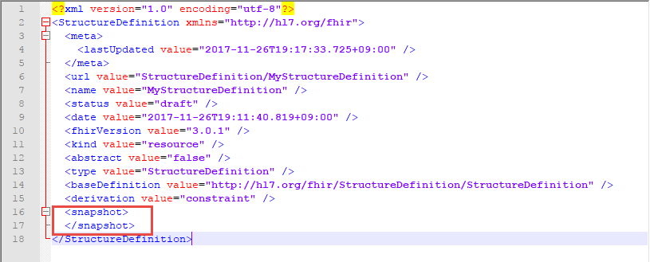
FHIR Validation
Add snapshot element in textEditor

Slide 12
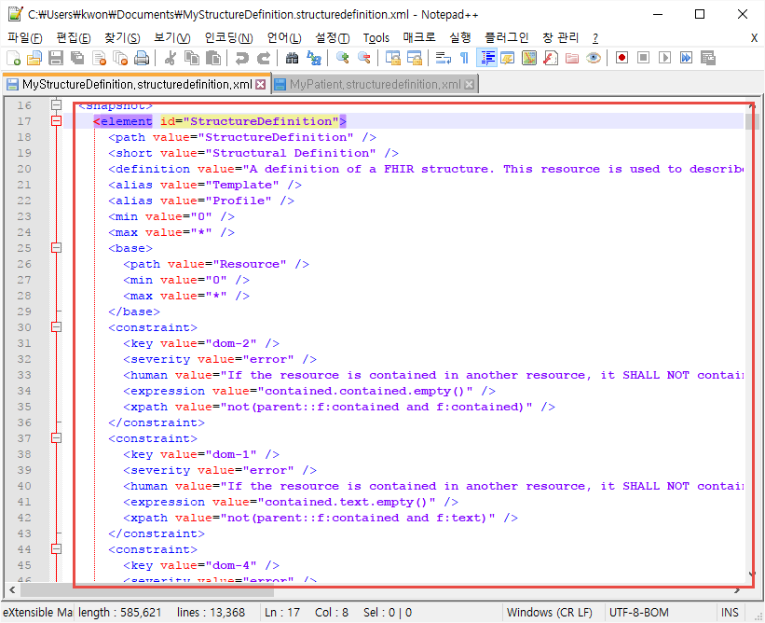
FHIR Validation
Setting options and save again and then you snapshot is made

Slide 13
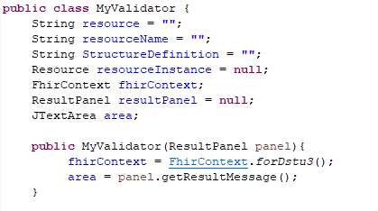
FHIR Validation
Make class

Slide 14
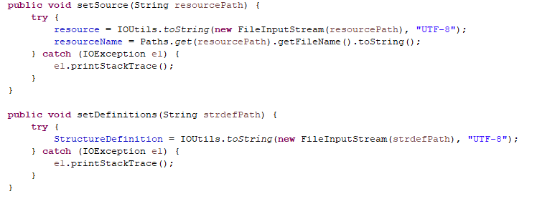
FHIR Validation
Make Method into MyValidator

Slide 15
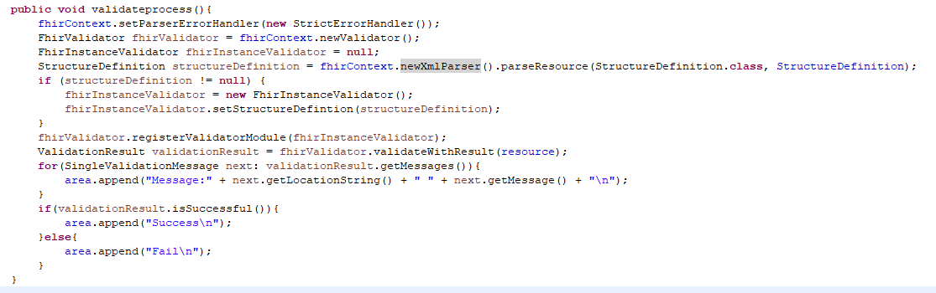
FHIR Validation
Make Method into MyValidator

Slide 16
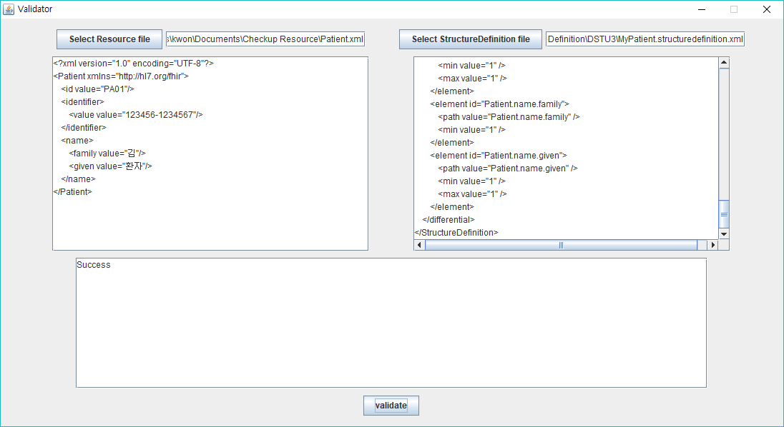
FHIR Validation
Validating result

Slide 17
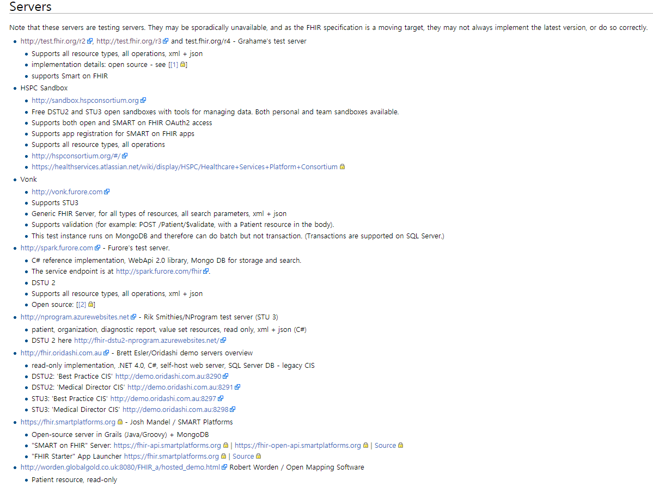
FHIR Server
Server List

Slide 18
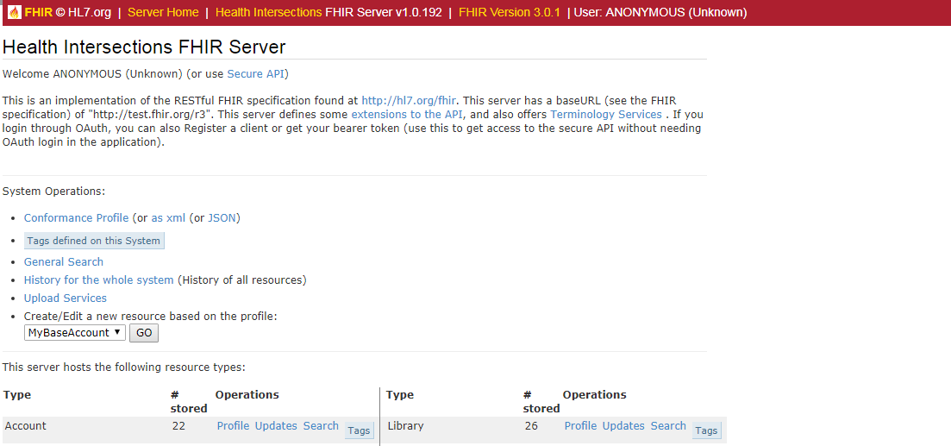
Grahame’s test server
Server
http://test.fhir.org/r3

Slide 19

Vonk FHIR Server
Vonk FHIR Server
http://vonk.furore.com/

Slide 20
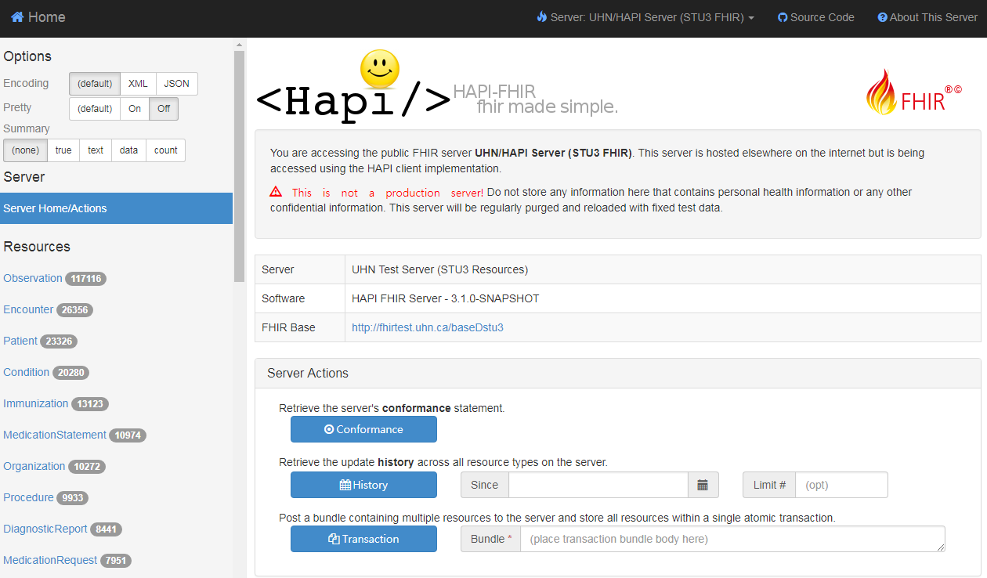
HAPI FHIR Server
HAPI FHIR server
http://fhirtest.uhn.ca/

Slide 21
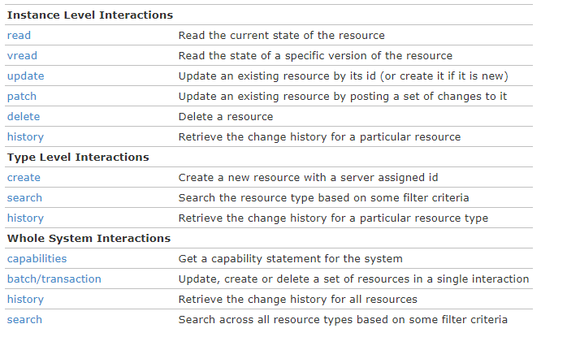
Interaction with server

Slide 22
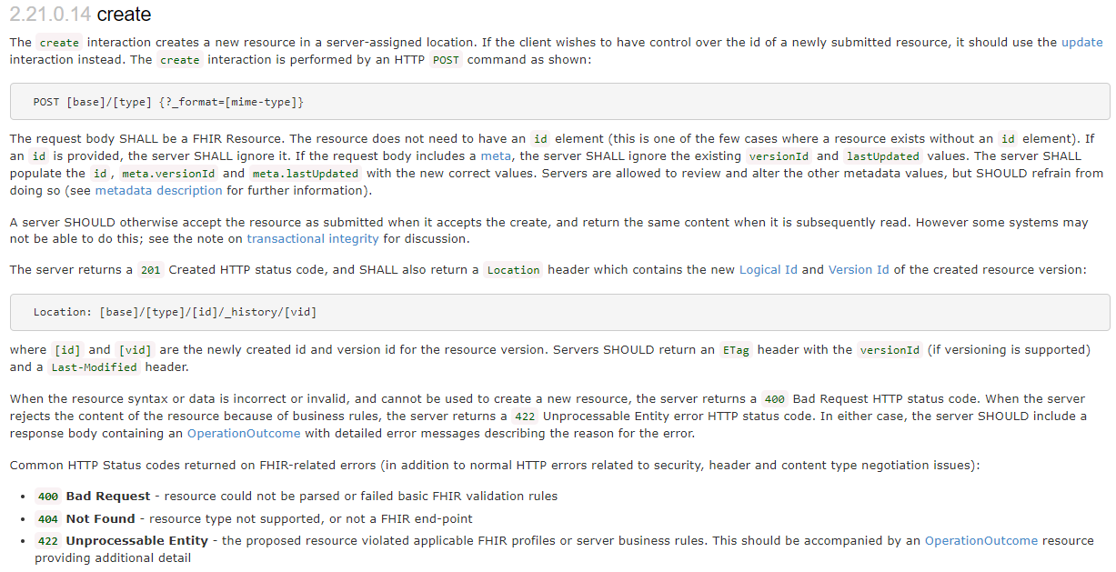
Send Resource to Server

Slide 23
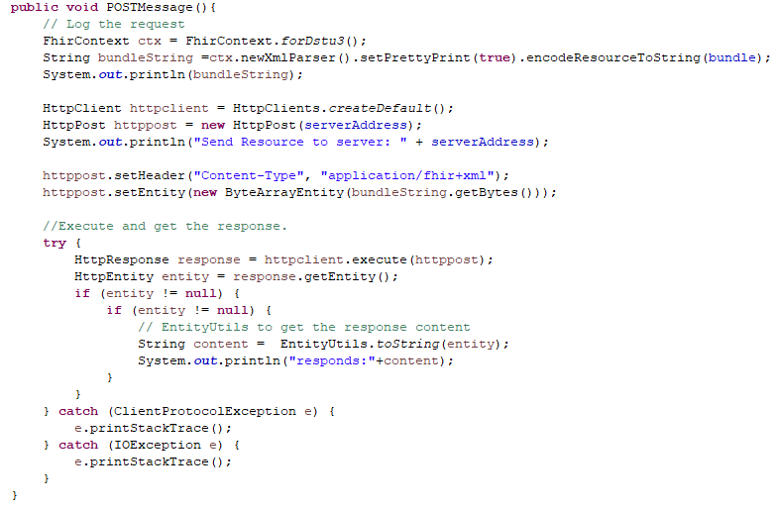
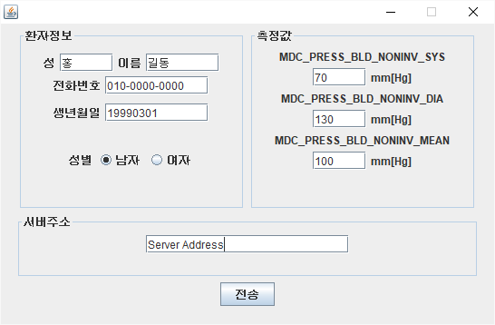
Send Resource to Server

Slide 24
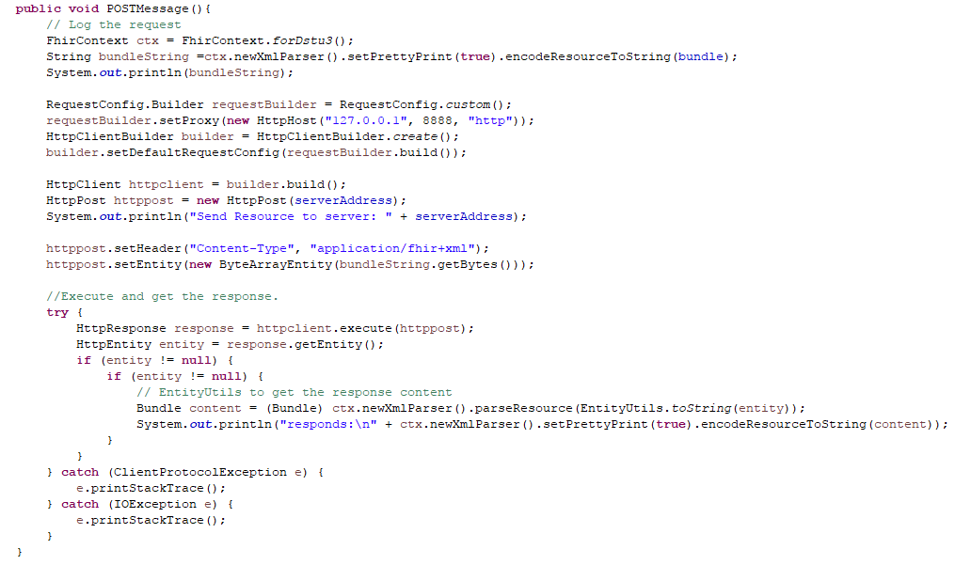
Source code

Slide 25
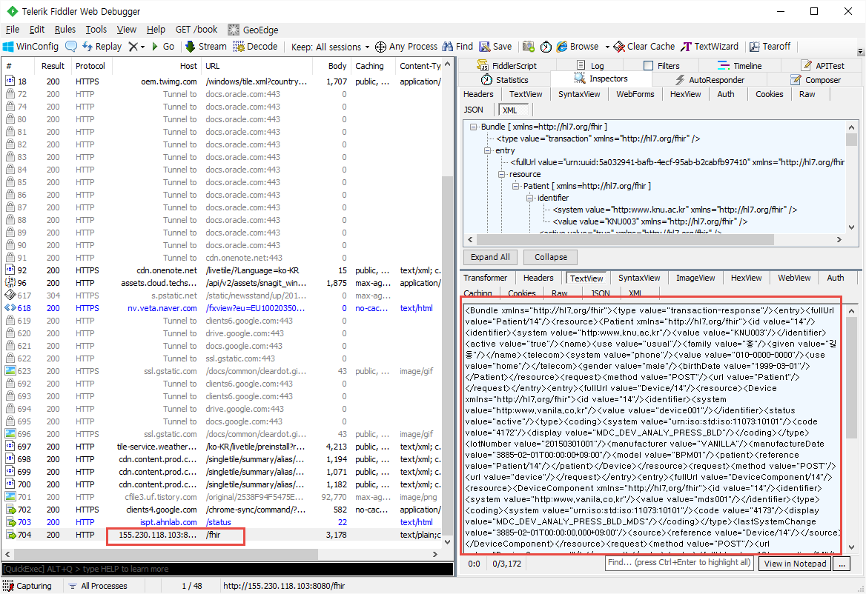
Check Response
Fiddler

Slide 26
Assignment
1. Make Observation Resource that can describe Oxygen Saturation
(source code, result screenshot)
2. Validate Resource(Patient Resource).
(source code, result screenshot)
You don’t have to make GUI. It can be shown in console result.
3. Send Bundle Resource that contain Observation, Device, Patient Resource to FHIR
server(http://155.230.118.103:8080/fhir)
Screenshot (fiddler response)
Score: 2 point
Submission Deadline: December 3 11:59:59 PM

Slide 27


